Slide 1
Records Managers Online Forum
31 October 2023

Slide 2
Agenda
Topic | Presenter | Time
1. Good recordkeeping animation video | Martyn Killion | 5 min
2. State of recordkeeping in NSW | Catherine Robinson | 25 mins
3. State Records Act – implementation of access and transfer provisions | Kristy Tiberi | 25 mins
4. Preservation of records | Elizabeth Hadlow | 25 mins
5. State Records NSW updates | Laura Baldwin | 10 mins
6. Q&A and wrap-up event | Martyn Killion | 10 mins

Slide 3

Good recordkeeping animation video

Slide 4
State of recordkeeping in NSW
Catherine Robinson
Senior Project Officer State Records NSW

Slide 5
Recordkeeping Monitoring Exercise 2023
Each year State Records NSW conducts a Recordkeeping Monitoring Exercise
Section 12(4) of the State Records Act 1998 requires each public office to report on its records management program in accordance with arrangements made with State Records NSW
Public offices use the Records Management Assessment Tool (RMAT) to self-assess the conformity and maturity of the records management program and then provide these assessments to State Records NSW
Assessment outcomes are scored and each public office receives an overall score out of 5 for maturity and compliance

Slide 6

Thank you
Thank you to public offices for their cooperation and participation in the 2023 Recordkeeping Monitoring Exercise

Slide 7
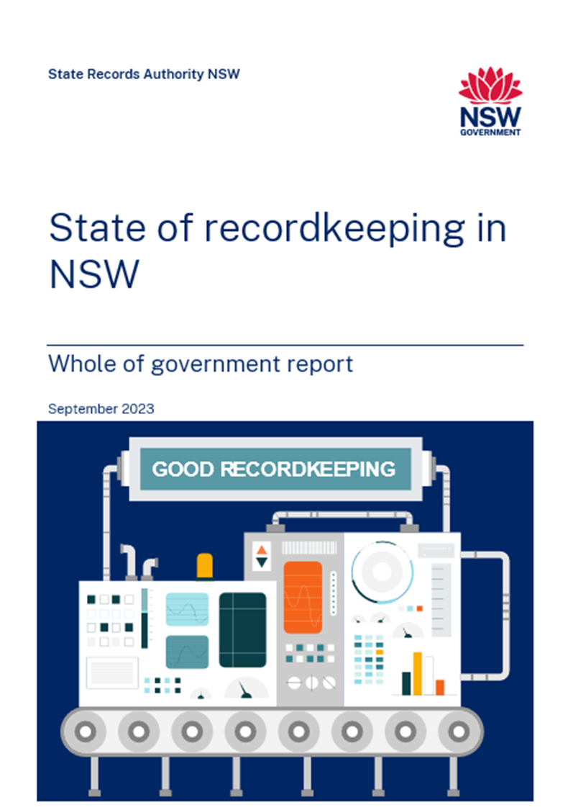
Report provides aggregate/summary results for the 2023 Recordkeeping Monitoring Exercise
Results can be used for benchmarking against the rest of the jurisdiction or by ‘public office type’
Results and public office comments will assist State Records NSW
Report available at https://staterecords.nsw.gov.au/guidance-and-resources/state-recordkeeping-nsw/

Slide 8

Key Findings
278 public offices participated in the annual Recordkeeping Monitoring Exercise in 2023, up from 247 in 2022. | This represents a response rate of 74% in 2023, up from 65% in 2022. Those who did not submit are listed at Appendix A.
38% of participating public offices in 2023 have scores which identify them as ‘mature’ in their records management, up from 30% in 2022. | In 2023, the overall records management maturity score is 2.79 out of 5, up from 2.67 in 2022.
Five assessment questions are now above baseline compliance (Question 3 on Senior Responsible Officer for records management, Question 10 on Security & Protection of records, Question 14 on Systems Design, Question 15 on Create, Collect, Capture, and Question 16 on Storage of records). | The three lowest scoring assessment questions are Question 8 on Outsourcing & contracts, Question 9 on Performance monitoring, and Question 18 on Transfer to the State Archives Collection.

Slide 9
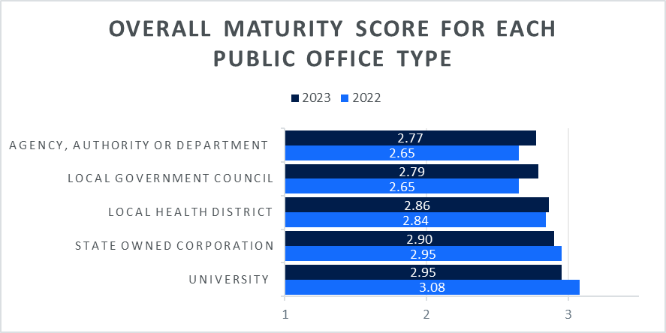
Overall maturity score for each public office type

Slide 10
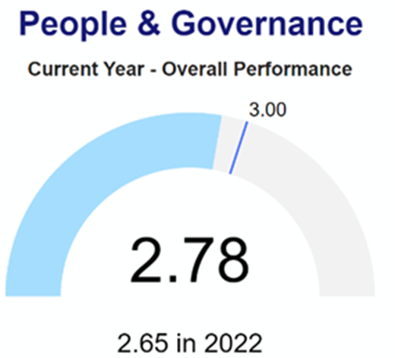
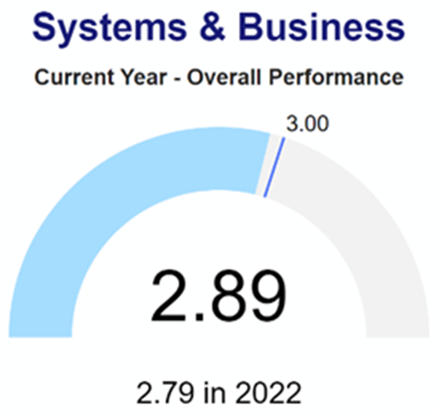
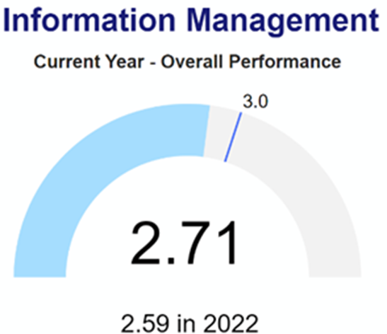
RMAT Categories

Slide 11
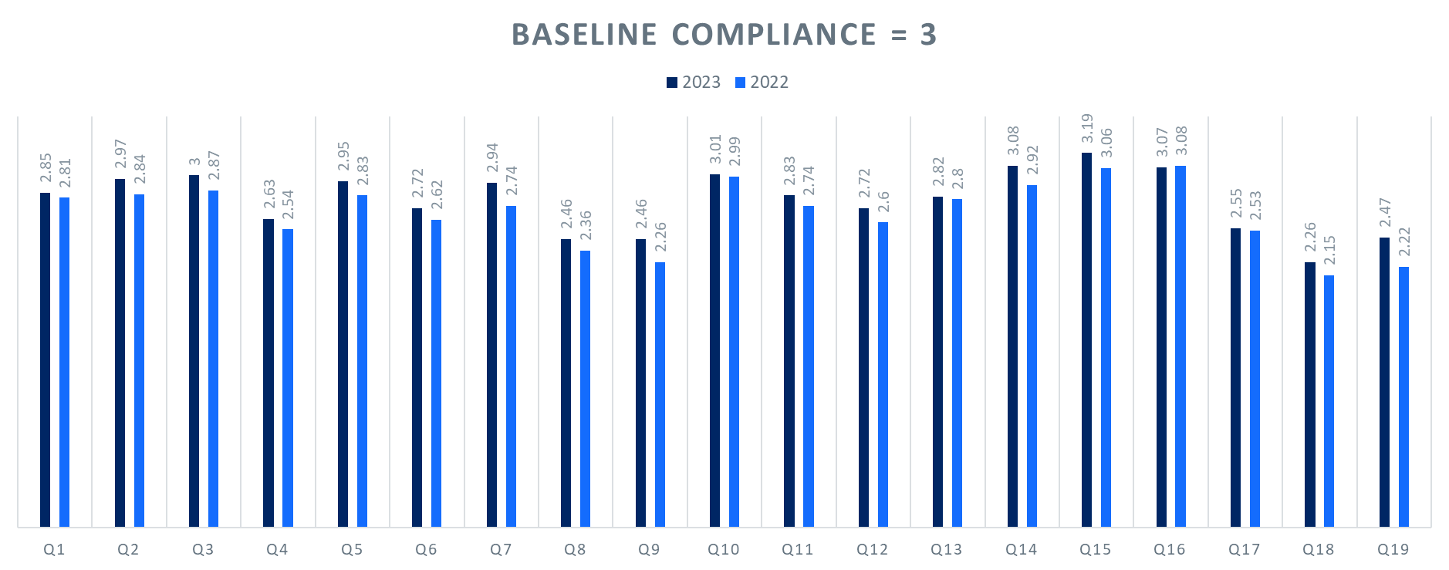
Results of each question

Slide 12
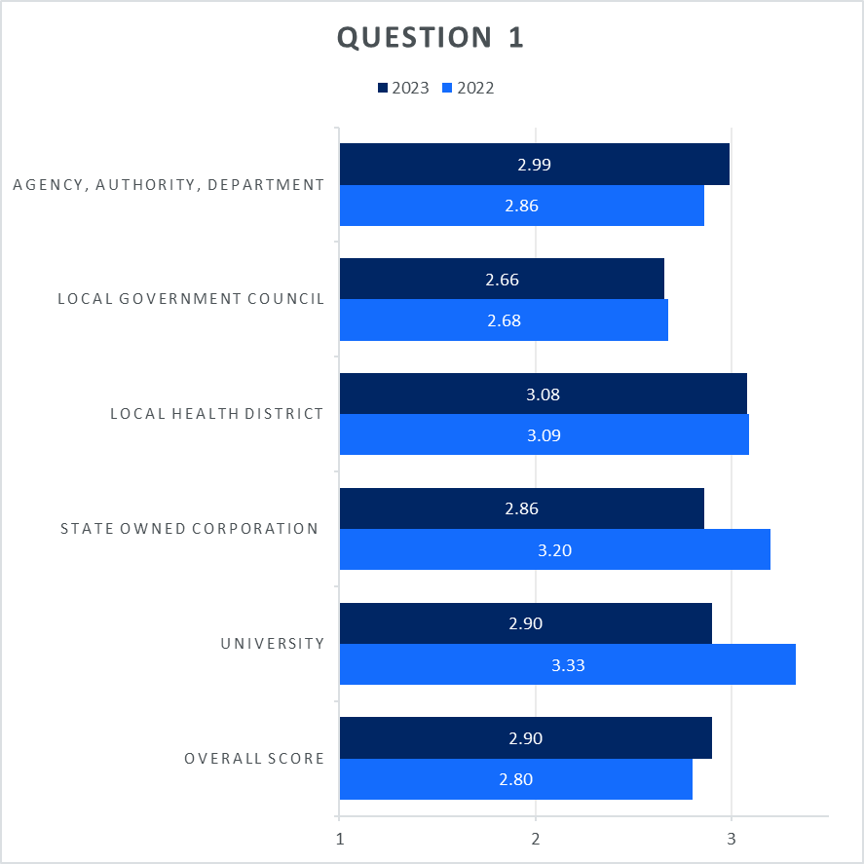
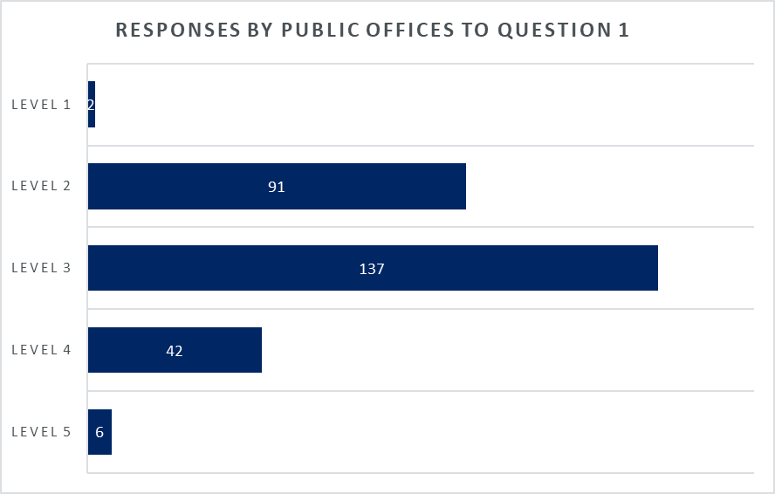
Information provided for each question

Slide 13
Scorecards
State Records NSW is preparing a scorecard for each public office that made a submission to the 2023 Recordkeeping Monitoring Exercise
Scorecard provides a snapshot of the public office's assessment results and includes:
  overall maturity score
  overall maturity compared to the jurisdiction
  public office score for each RMAT category
  Assessment scores for each question compared with the 2022 results
Scorecards will be sent to the Chief Executive and SRO for the public office

Slide 14
Next steps
2024 Recordkeeping Monitoring Exercise will be held 1 March – 5 April 2024
Submissions should be made via the Service Portal
Communications will be sent to all public offices before the 2024 Exercise starts
What can you do to prepare?
  Review this year's assessment and benchmark against other public offices
  Identify where work has been done over 2023
  Identify work that needs to be done to improve gaps in conformity and maturity (Remember to update your Records Management Strategy!)
  Identify the evidence that supports the level of maturity you have chosen
  Contact us at govrec@staterecords.nsw.gov.au if you have any questions about the Recordkeeping Monitoring Exercise

Slide 15
State Records Act 1998 -Implementation of access and transfer provisions
Kristy Tiberi
Senior Advisor Agency Services, MHNSW

Slide 16
Communication of State Records Act changes
State Records Act amended
31 December 2022
Information sessions with public office clusters
February to May 2023
Email from MHNSW Chief Operating Officer to all Senior Responsible Officers
April 2023
Live webinars on using the access direction tool hosted
May & June 2023
Presentation of Access Direction Tool to Records Managers Forum
March 2023
Targeted engagement with outstanding public offices
July to September 2023
Email from Director, Collections sent to Senior Responsible Officers of outstanding public offices
October 2023
MHNSW CEO to write to Chief Executives of outstanding public offices
November 2023
Deadline to register access directions
8 December 2023
All State records without CPA directions default to open
1 January 2024

Slide 17
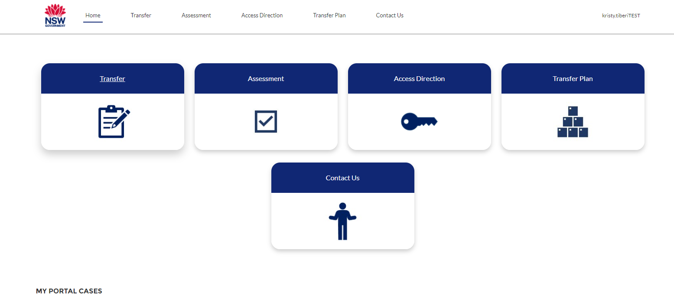
Demonstration of prototype Transfer Plan for 2024

Slide 18
Preservation of records
Elizabeth Hadlow
Senior Advisor Conservation, MHNSW

Slide 19
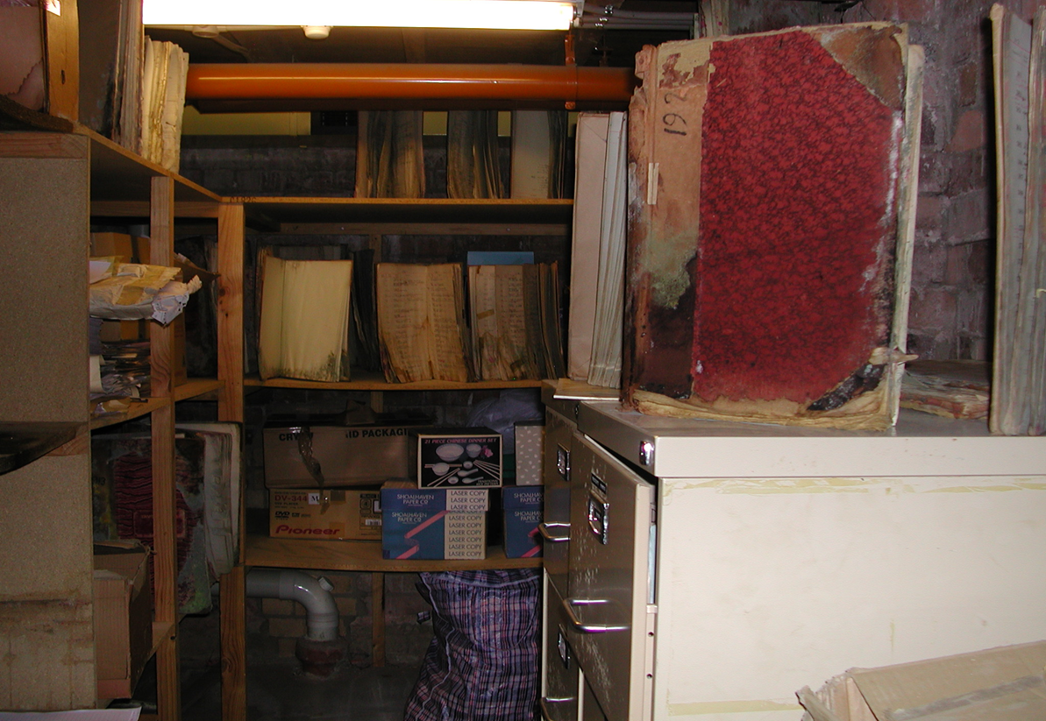

Control is key
Answering these questions is the best place to start
  What do you have
  Where is it stored
  How long do you need to keep it
  Who accesses the records
  How often are the records accessed

Slide 20
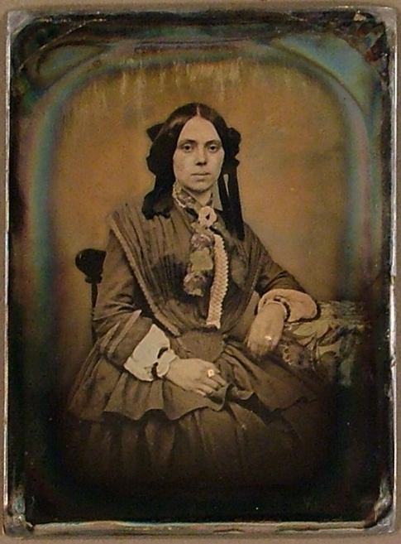
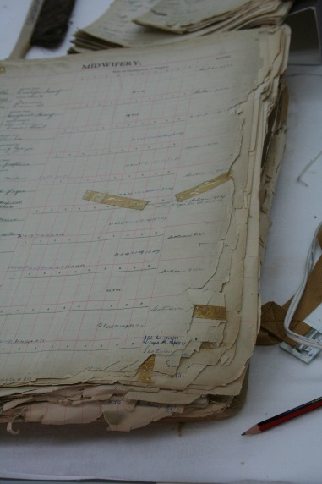
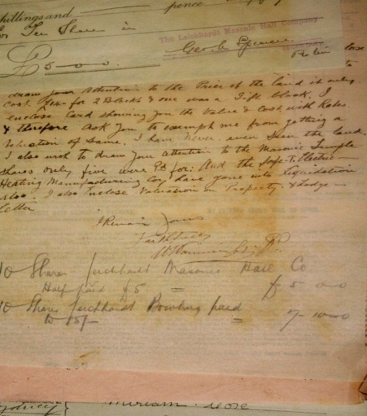
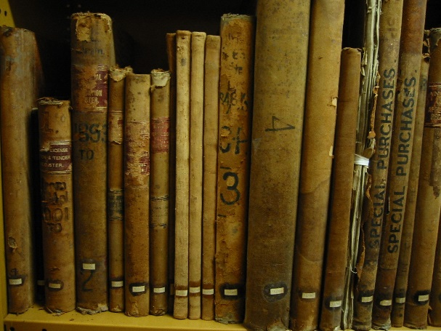
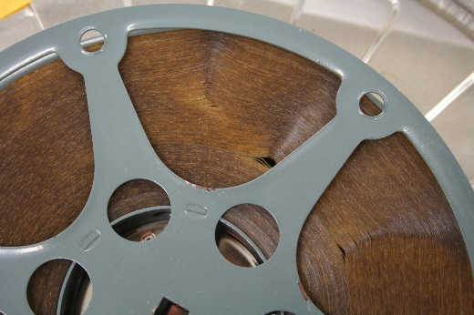
What you have makes a difference to its care
Paper
  20 degrees; 50% RH
  Documents
  Books
  Maps and plans
Audio-visual and photographs
  6 degrees; 35% RH
  Magnetic cassette and reel taps
  Video
  Cinematic and photographic film
Anything else?
  Parchment
  Architectural formats, e.g., drafting linen

Slide 21
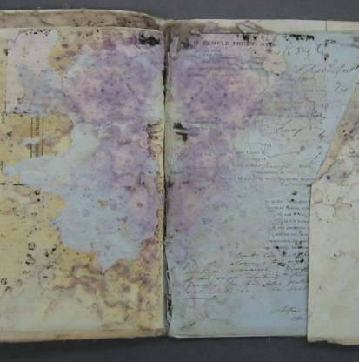
Records’ natural enemies
High temperature
High humidity
Light
Pollutants
Mould
Pests
Handling and bad repairs

Slide 22
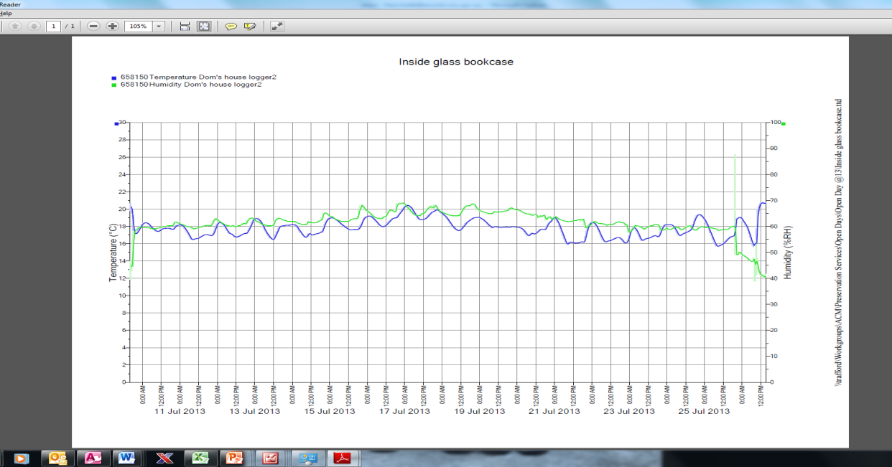
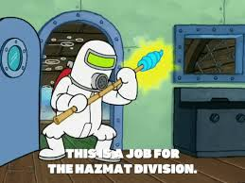

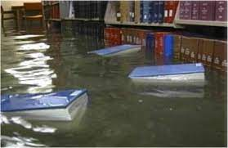
Constant, Cool, Clean, Dark and Dry
Stable environment
Temperature 20 degrees
Relative Humidity 45-50%
No light if possible
Keep it clean!
Monitor for pests
Can water get in?....

Slide 23
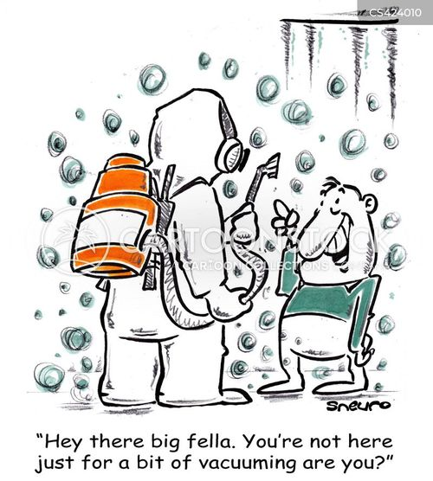
You’ve got mould……
Isolate
Test
  Records
  Storage area
  HVAC system
Remediate
  Records
  Storage area
  HVAC system
Copy
Can you destroy?

Slide 24
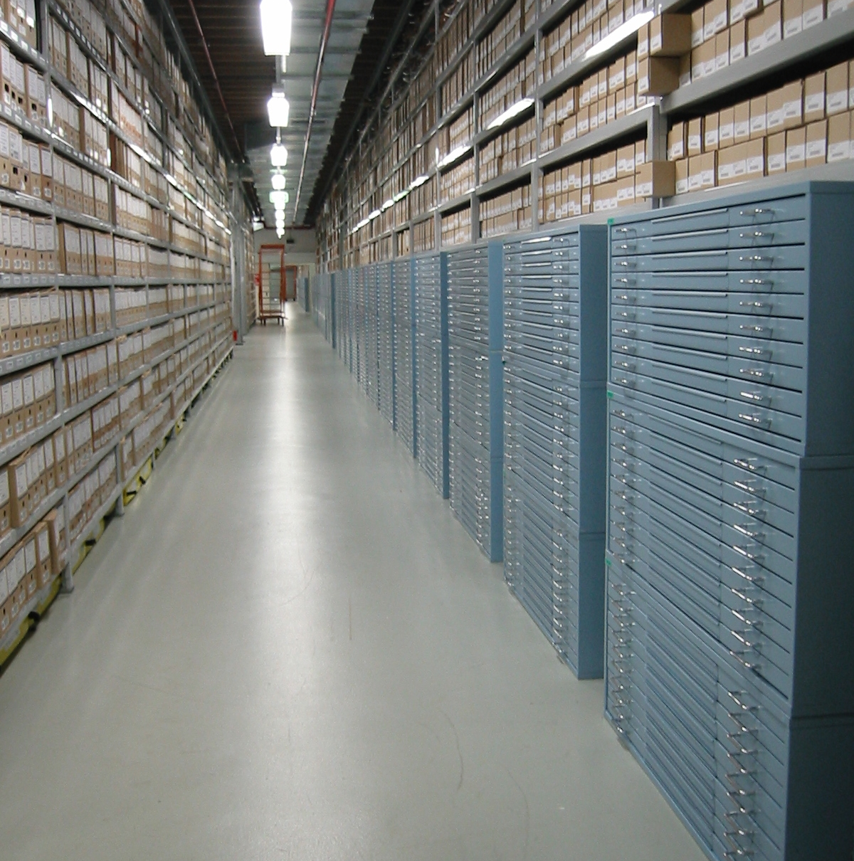
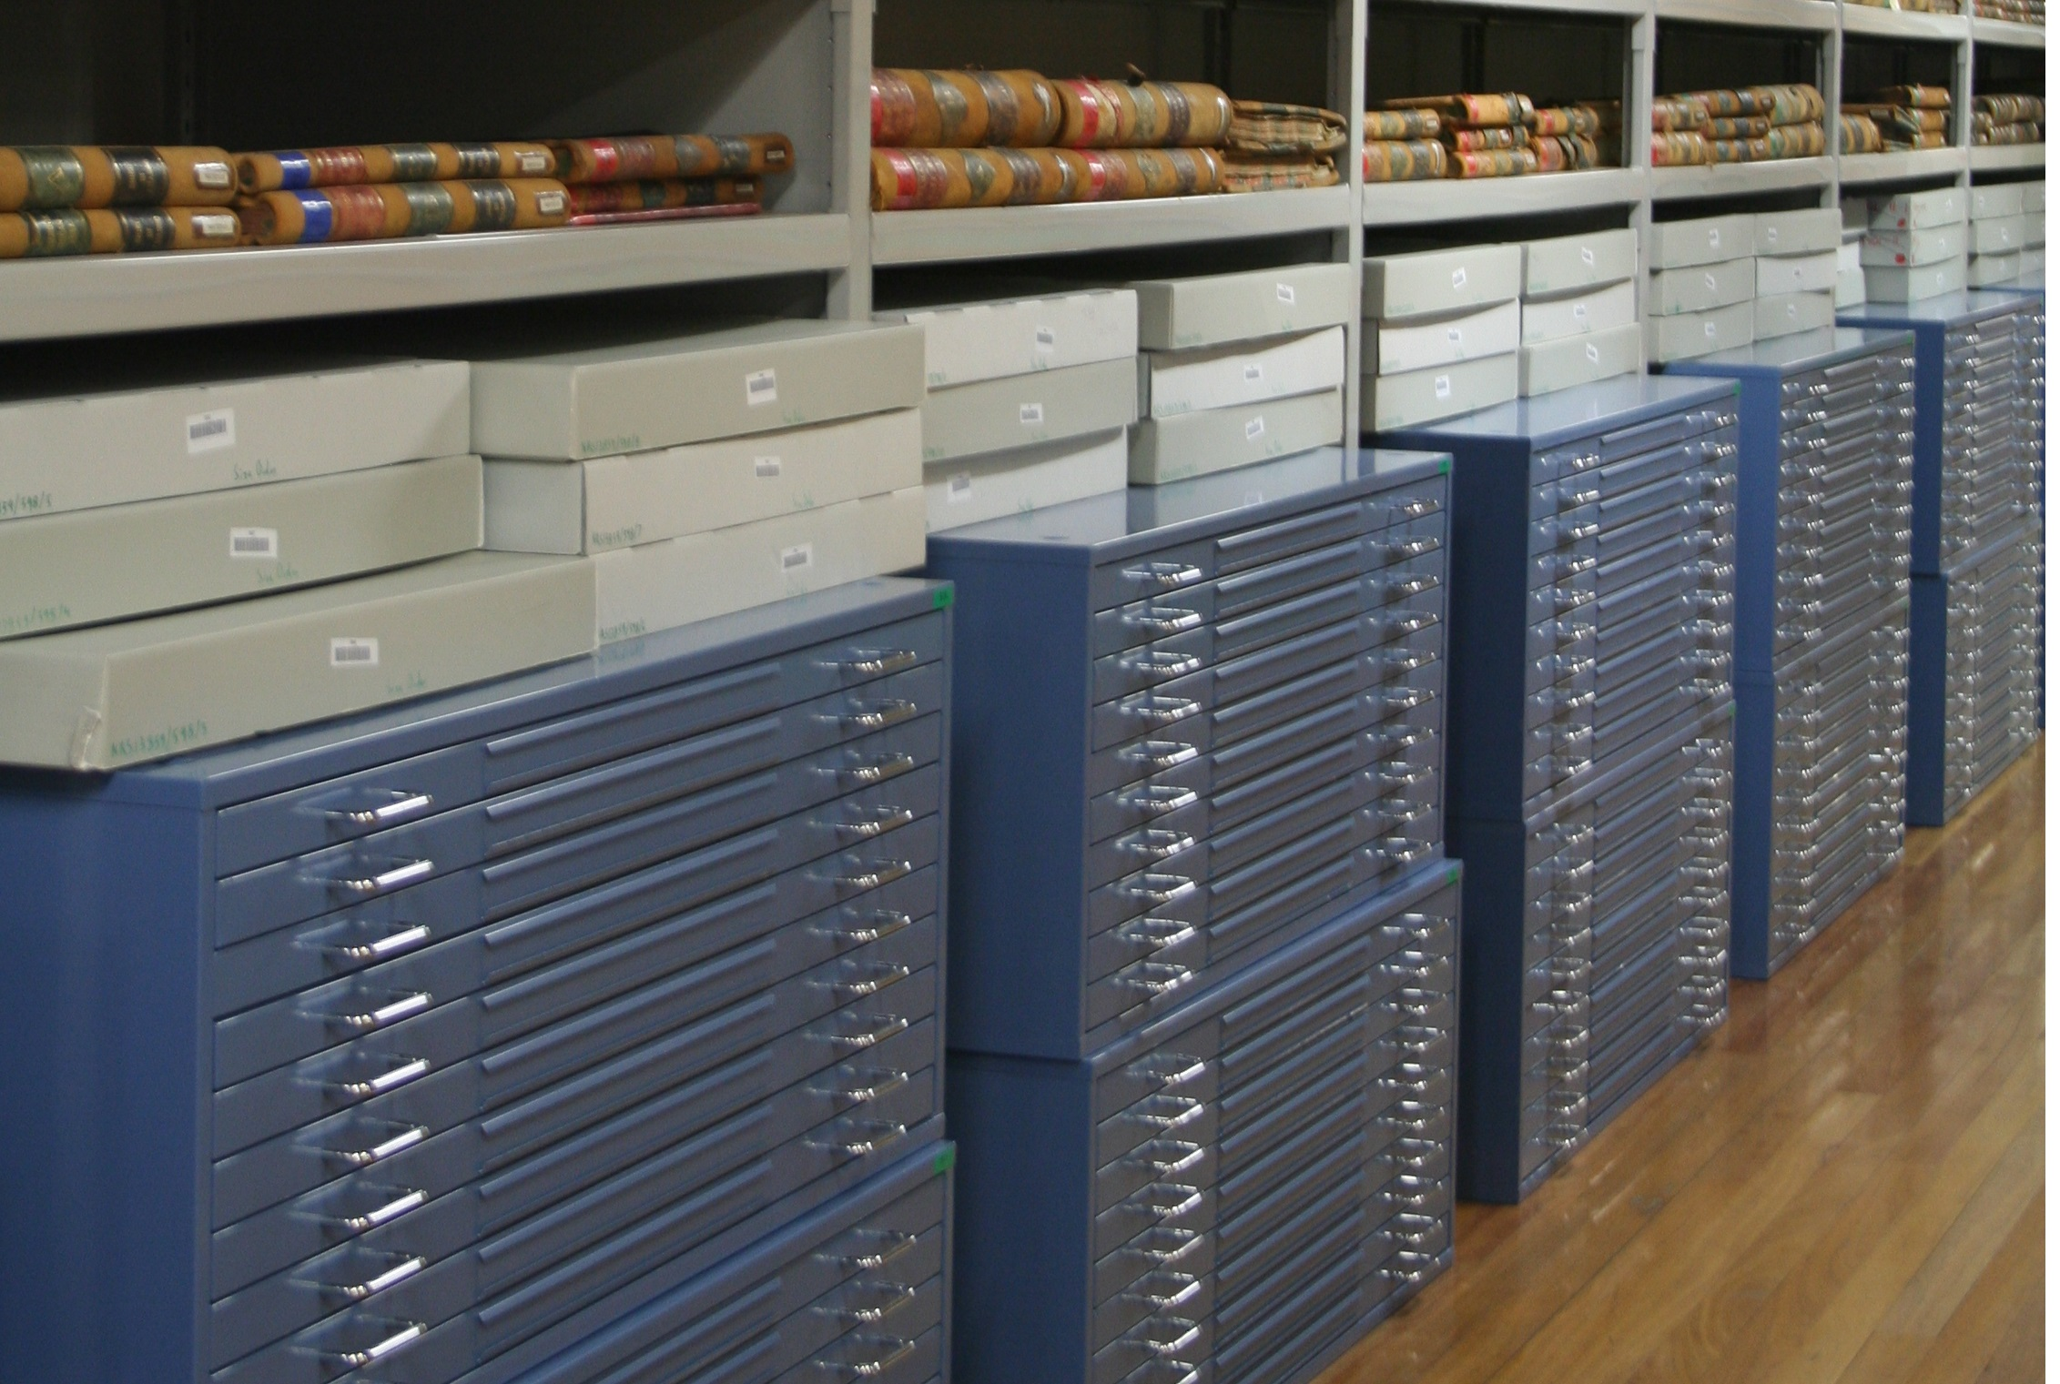
Sentence and transfer
Solves all the questions at the start
No ongoing cost
Continued access for all
Best long-term preservation outcome
BUT – before you transfer the condition of the records needs to be acceptable for ongoing access and use.
So, what is acceptable?

Slide 25
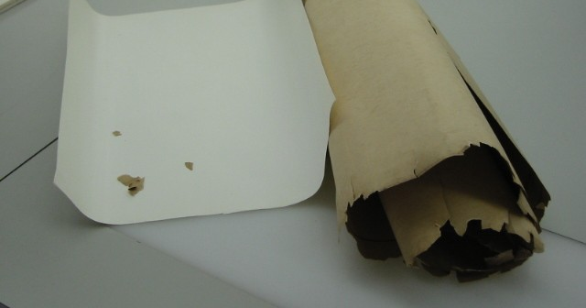
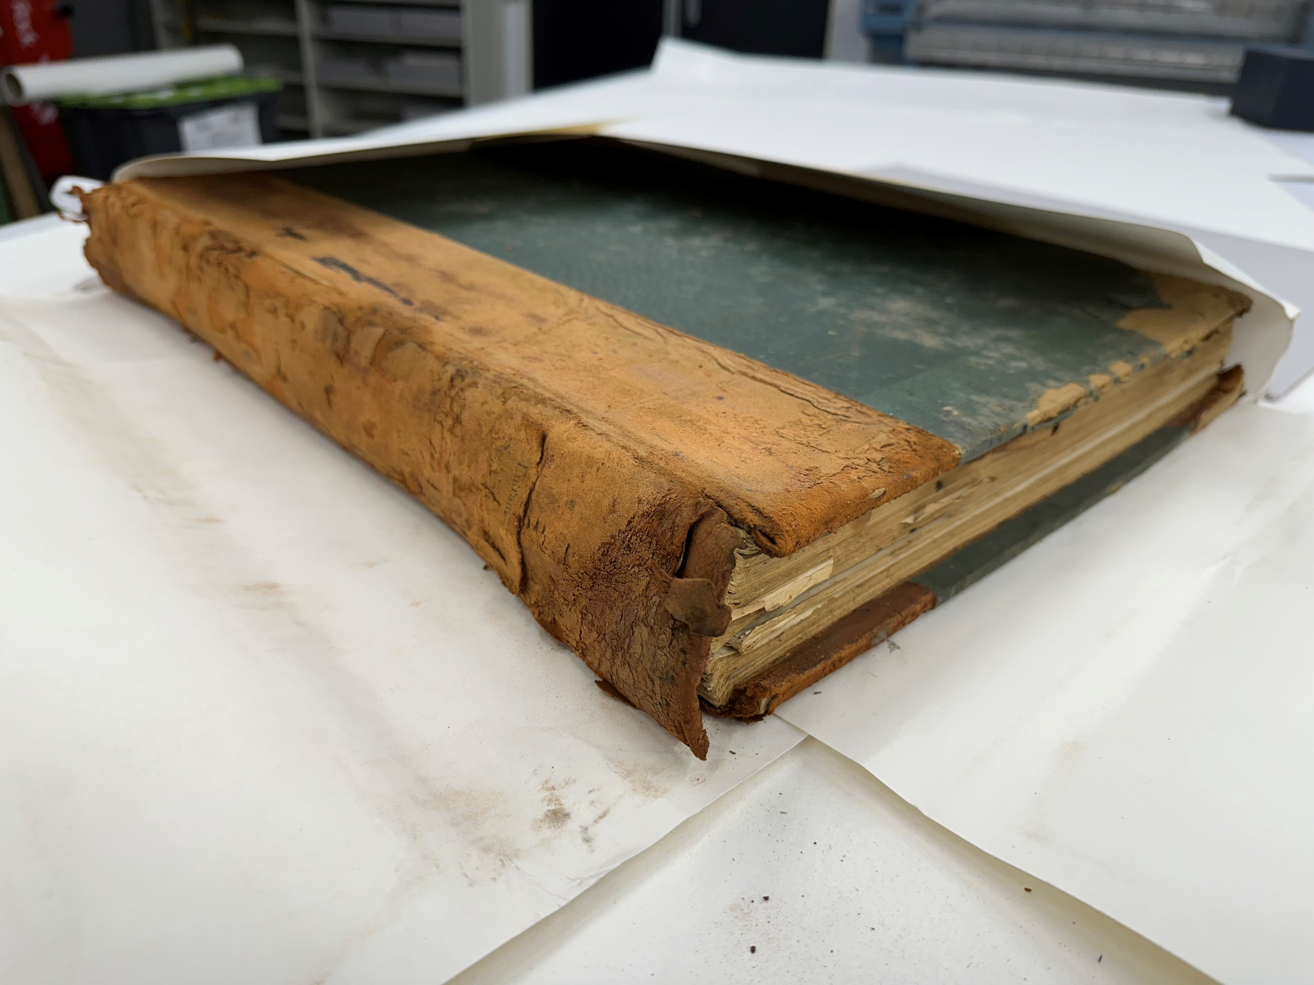

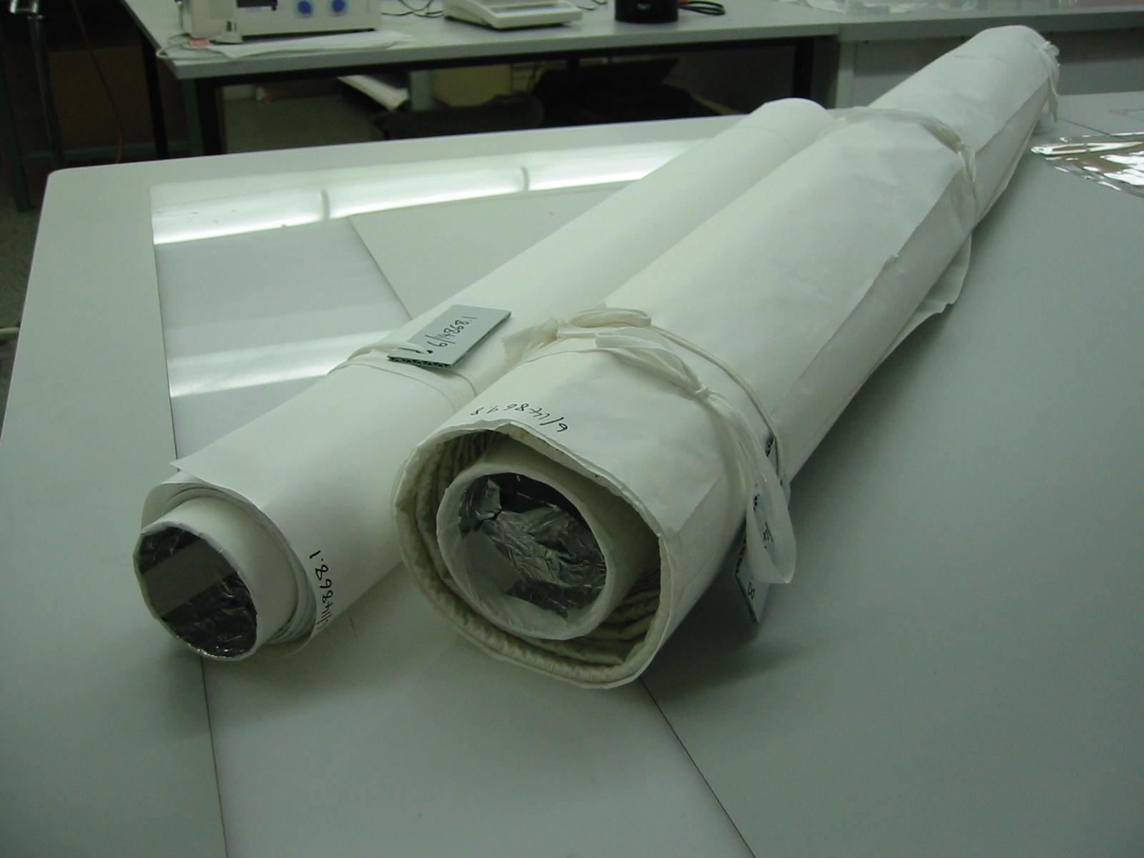



What is acceptable for transfer?
Contact Agency Services
Records must be safe to handle and access
Mould contamination must be cleaned and tested
Treatment to return to “original condition” is unnecessary

Slide 26
State Records NSW updates
Laura Baldwin
Manager State Records NSW

Slide 27
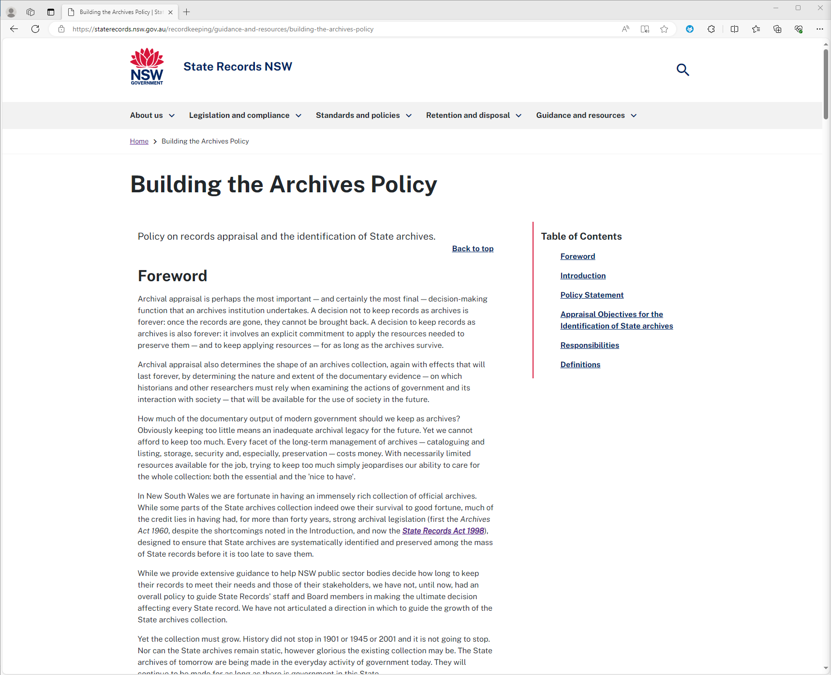
Building the Archives Policy review
Current policy on records appraisal and identification of State archives
Published 2001
Broad consultation in May-June 2023
Draft policy released for feedback 4-31 October 2023
Report on consultation and draft policy available on our website

Slide 28
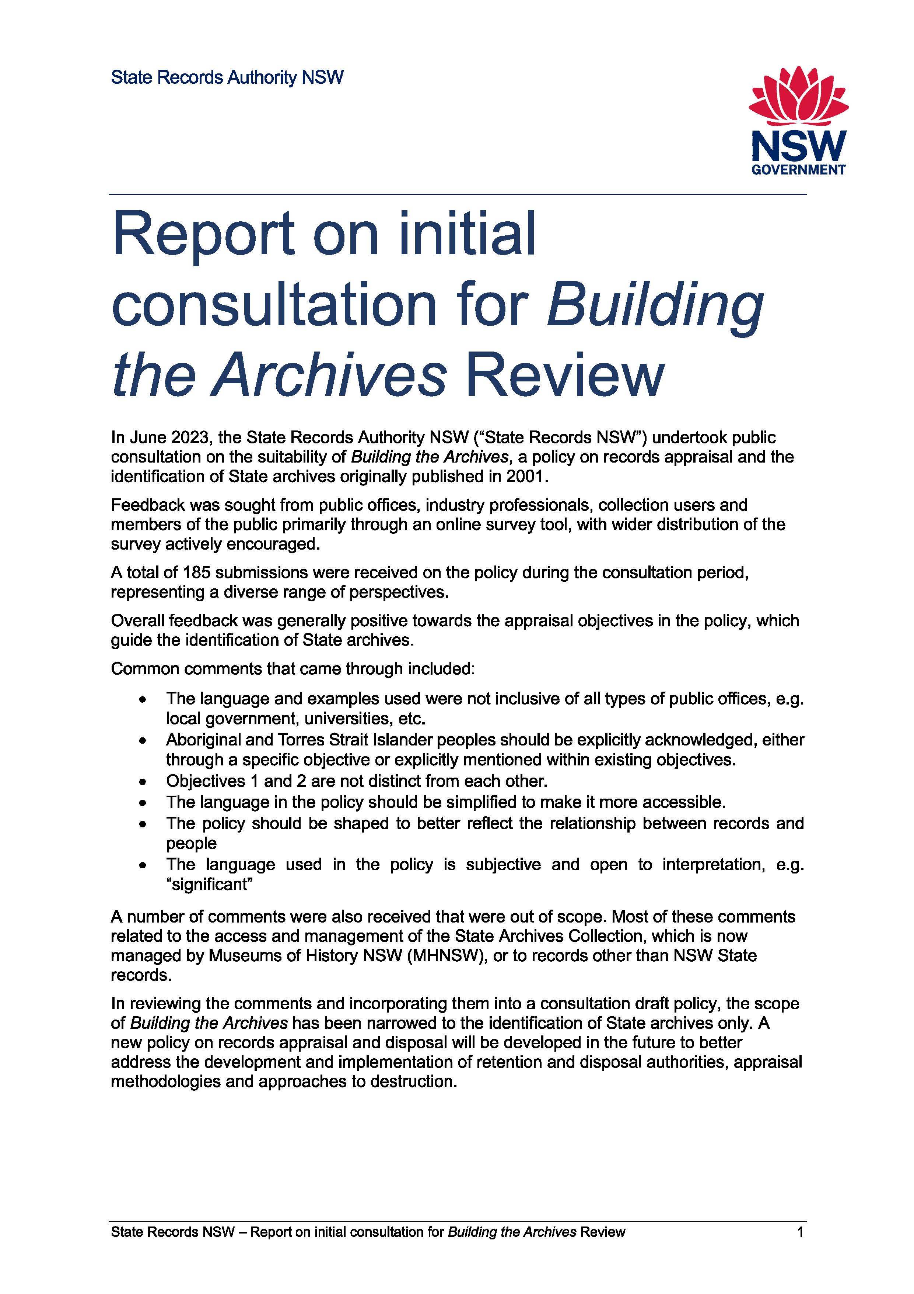
Building the Archives consultation results
Common comments included:
Language and examples should be more inclusive of public office types
First Nations people should be explicitly acknowledged
Objectives 1 and 2 are too similar
Language should be more accessible
Relationship between records and people should be clearer
Language should be less subjective

Slide 29
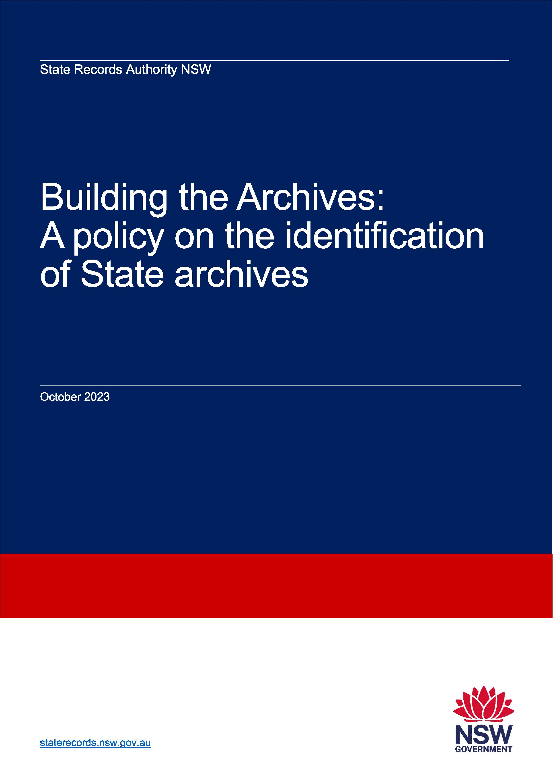
Building the Archives – Draft Policy
Key changes include:
Limiting scope to identification of State archives only
Existing Objectives 1 and 2 have been combined
New Objective 3 has been added – focus on individuals
Explicit acknowledgement of records of First Nations and vulnerable peoples

Slide 30
Retention and disposal authorities
Draft retention and disposal authority for identity verification records
Draft retention and disposal authority for local government
Recently approved:
Management of Crown Lands
Supreme Court of NSW
Major Infrastructure Projects

Slide 31
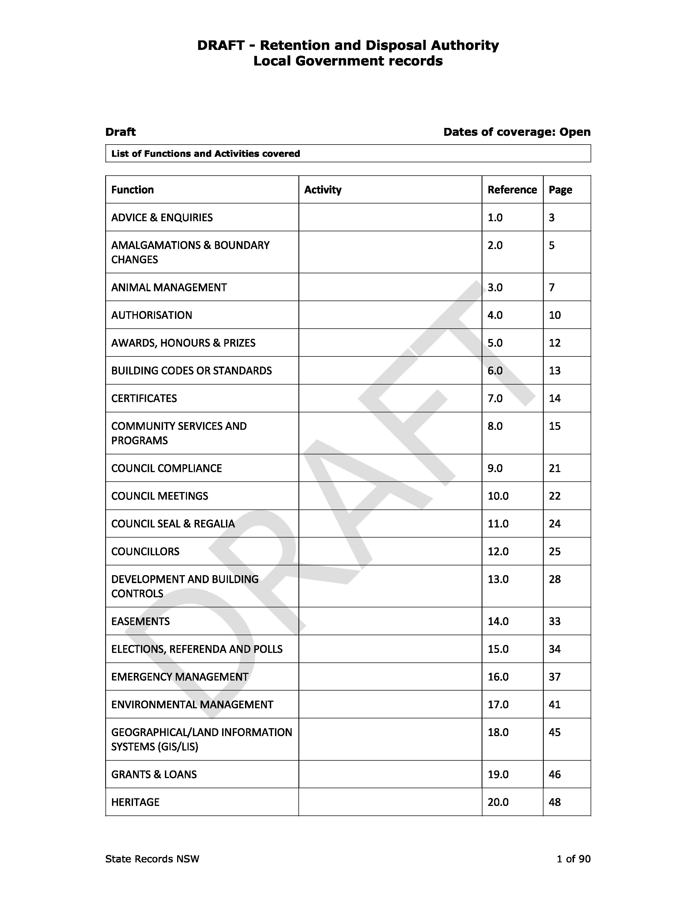
Retention and disposal authority for local government
Following review of GA39
Number of entries reduced
Removal of common administrative records already covered under GA28
2-level structure
Exposure draft available on our website
Feedback is requested by 15 December 2023

Slide 32
Questions?

Slide 33
Contact
For information about your recordkeeping obligations, contact State Records NSW
govrec@staterecords.nsw.gov.au
For more information about access and transfer, contact Museums of History NSW
transfer@mhnsw.au
Notes:
Stop presenting at this slide.
Thank hosts again. Time permitting, offer to hang around to answer more questions informally.

Slide 34
Thank you
Notes:
End slide

